Slide 1

RUNGTA COLLEGE OF DENTAL SCIENCES & RESEARCH
Nuclear Medicine
Dr. Fatima Khan
ORAL MEDICINE, DIAGNOSIS & RADIOLOGY

Slide 2
Specific learning Objective
CORE AREAS | DOMAIN | CATEGORY
INTRODUCTION | AFFECTIVE | DESIRE TO KNOW
SPECT | COGNITIVE | NICE TO KNOW
PET | COGNITIVE | MUST KNOW
SCINTIGRAPHY | COGNITIVE | MUST KNOW

Slide 3
Contents
INTRODUCTION
SPECT (SINGLE POSITRON EMISSION TOMOGRAPHY)
PET (POSITRON EMISSION TOMOGRAPHY)
SCINTIGRAPHY
CONCLUSION
REFERENCES
PROBABLE QUESTIONS

Slide 4
Radio isotope imaging
This relies on altering the patient by making the tissue radioactive.
This is done by injecting certain radioactive compounds into the patient that have the affinity for particular tissues- so called target tissues.
The radaioactive compounds become concentrated in the target tissues and their radiation emissions are then detected & imaged using a stationary gamma camera

Slide 5
SINGLE POSITRON EMISSION COMPOTED TOMOGRAPHY -SPECT
SPECT scan let us analyze the function of some of our internal organs.
SPECT scan is a type of nuclear imaging test, which means it uses a radioactive substance and a special camera to create 3-Dpictures.

Slide 6
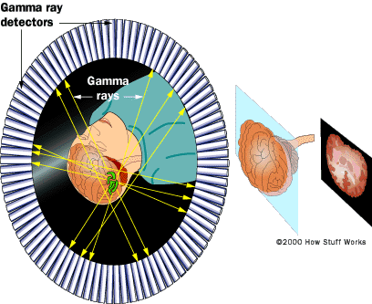
SPECT is a method of acquiring tomographic slices through a patient. Most gamma cameras have SPECT capability. SPECT images have been fused with CT images to improve identifying location of radionucleide.
In this technique either a single or multiple gamma camera is rotated 360 degree about the patient.
.

Slide 7
Image acuisition takes about 30-45min.
These data can be used to reconstruct multiplanar images of study area. Tomography enhances contrast and removes superimposed activity.
With SPECT, the 3D radioactivity distribution within transverse slices is reconstructed from 2D projection images acquired at different angles around the patient.
The reconstructed image will have a better contrast resolution, which will help to detect smallest size lesion especially for deeply located lesions.

Slide 8
One of the main problems in SPECT is attenuation: γ-rays emitted inside the patient can undergo photoelectric absorption or Compton scatter, resulting in a loss of detected counts.
The degree of attenuation depends on the energy of the γ-ray, on the type of material it passes through, and on the distance it travels through the attenuating material.

Slide 9
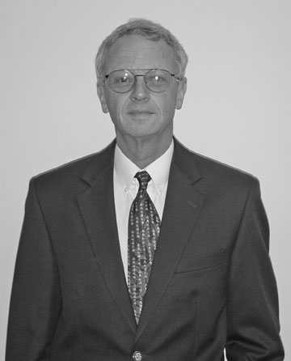
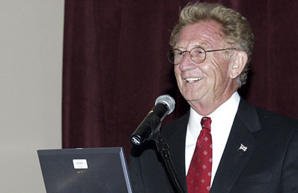
Positron Emission Tomography
PET is more advanced imaging modality , sensitivity 100 times than that of gamma camera, relies on positron-emitting radionucleide.
Dr. David Townsend & Dr. Ron Nutt Invented in 1970
.

Slide 10
PET is based not only on its sensitivity but on the fact that radionucleide isotopes( 11Carbon,13 Nitrogen, 15 Oxygen, 18 Flourine) used are naturally occuring in organic molecules.
These radionucleides are incorporated into radiopharmaceuticals such as glucose or amino acids by use of cyclotron.
After the radiopharmaceutical is injected into the patient, the isotope distributes within the body’s tissue according to the carrier molecule and emits a positron.

Slide 11
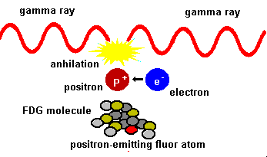
This positron then interacts with a free electron and mutual annihilation occurs, resulting in production of two 551 Kev photons emitted at 180 degrees to each other.
The PET scanner consists of a ring of many detectors in a circle around the patient.
System detects pairs of gamma rays emitted indirectly by a positron emitting radionuclide which is introduced into the body on a biologically active molecule

Slide 12
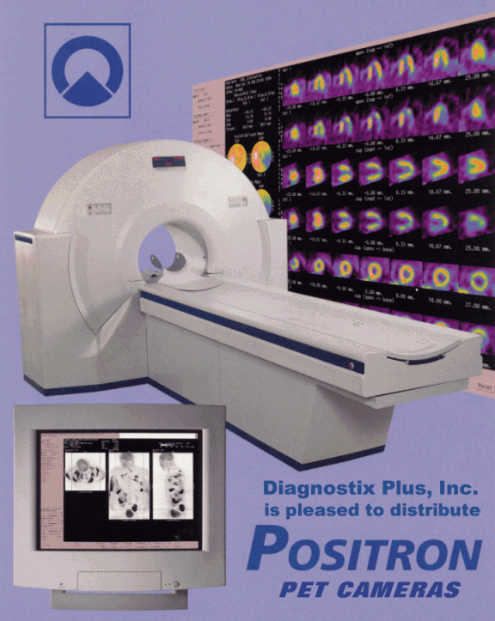
The detector crystals are often made of bismuth germiante.
Raw PET scan data consists of a number of these coincidence lines, which are recognized into projections that identify where isotope is concentrate within the patient.

Slide 13
With FDG-PET,(Fluorodeoxyglucose) cancer detection and characterization is based on changes in glucose metabolism in tumor cells, which usually show a high FDG uptake as a consequence of their well-known high rate of glycolysis (the Warburg effect).
FDG-PET imaging is performed in the fasting state (at least 5–6 hours) in order to reduce blood insulin and glucose levels

Slide 14
FDG becomes alternative substrate for hexokinase; therefore, an increase of blood glucose leads for the tumor displacement .
The blood glucose level should be checked before FDG injection, and diabetic patients with a value > 200 mg/dl should be rescheduled for PET when their glycemia is under control.
Tumor uptake of FDG may increase even up to 2.5 hours after injection, and therefore it is important to use a standardized uptake time (at least 50 minutes) before imaging.
Imaging should include at least the regions extending from the frontal sinuses to the liver.

Slide 15
PET imaging is characterized by poorer spatial resolution than CT or MRI, and the normal distribution of FDG in the head and neck region is complex due to their complex anatomic structures to accurately localize FDG uptake .
In the head and neck, numerous structures show physiological uptake of FDG, such as muscles, lymphoid tissue, salivary glands, and brown tissue.

Slide 16
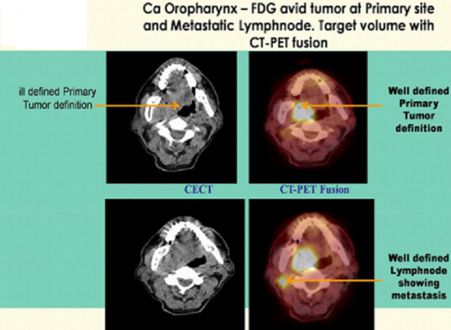
ILL DEFINED PRIMARY TUMOR
WELL DEFINE PRIMARY TUMOR

Slide 17
Indications
To investigate diseases at molecular level even in the absence of anatomical abnormalities apparent on CT or MRI
To determine the lesions exact anatomical position
Oncology- diagnosis of malignancy,staging of tumor,tumor charecterisation,restaging and surveillance
Nodal involvement before the node enlarges
In management of patients with epilepsy, cerebrovascular diseases,dementia and malignant tumors
Metastasis of carcinoma in different parts of the body

Slide 18
Limitations
High cost
Requires more space
Time consuming
PET scanning can give false results, if chemical balances within the body are not normal
The resolution of structures of the body with nuclear medicine may not be as clear as with other imaging tech such as CT or MRI

Slide 19
Interpretation
The cells or activity will show up as ‘hot sopts’ or ‘cold spots’
Hot spots these are the areas of increased metabolism
The active areas are bright on PET scan
Cold spots –These are the areas of decreased metabolism
The areas will be less bright

Slide 20
Scintigraphy
It is a primarily a functional test but also provides some information about structure and topography of salivary gland.
The examination is carried out with a gamma camera after intravenous injection of 74 millibecquerel of 99Tc-pertechnetate, which is selectively concentrated and secreted by the salivary gland.

Slide 21
Images are usually made during a period of 60-90 minutes and provides continuous monitoring of salivary dynamics.
The resolution of the imaging system is such that only tumors exceeding 1.5 cm in diameter are visualized.

Slide 22
Indications
Differentiation of benign and malignant masses is not possible as both do not concentrate pertechnetate resulting in a “Cold Spot”.
Warthin’s tumor and Oncocytoma take up more dye than the surrounding normal glandular tissue and appear as a “Hot Spot”
It is also useful to study the effect of radiation on salivary gland function and to detect subclinical salivary leakage after extensive neck surgery.

Slide 23
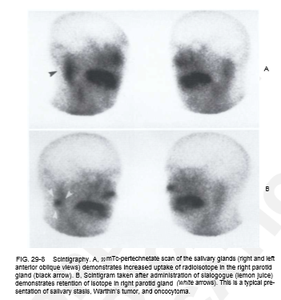

Slide 24
Acute sialadenitis shows increased pertechnetate concentration as a result of hyperaemia and delayed or absent isotope excretion caused by compression of ductal system by inflammatory edema.
In chronic sialadenitis, there is loss of ability to concentrate the dye, which reflects the parenchymal damage and interstitial fibrosis.
In case of sialoliths, it is used to determine the type of treatment, such as glandular excision or surgical removal of the stone.

Slide 25
It is particularily useful in diagnosis and follow up of patients with Sjogren syndrome.
An absolute indication of scintigraphy exists when the ductal orifice of major salivary gland cannot be found or cannot be cannulated.
Scintigraphic examination is performed within 10 days after onset of symptoms and if necessary, repeated 3 wks later to know whether stimulated excretion of dye from the submandibular gland on the affected side is normal or decreased or absent in comparision with healthy side.

Slide 26
Refrences
ORAL RADIOLOGY, STUART C. WHITE AND MICHAEL J. PHAROAH PRINCIPLES & INTERPRETATION, 8TH EDITION 2018
FRENY R. KARJODKAR. ESSENTIALS OF ORAL & MAXILLOFACIAL RADIOLOGY 2nd EDITION 2019

Slide 27
PROBABLE QUESTIONS
PET
APPLICATION OF PET
SCINTIGRAPHY

Slide 28
Thank you

